Slide 1
CSS Properties

Slide 2
Dimension Properties
List of dimension properties are as follows:
height
max-height
max-width
min-height
min-width
width

Slide 3
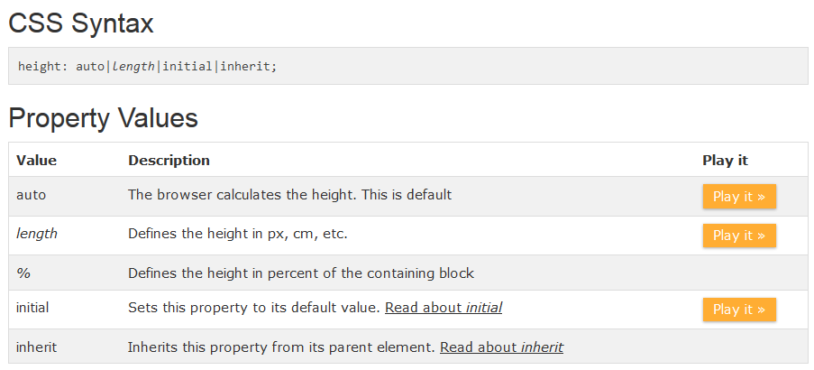
height property
The height property sets the height of an element.
Note: The height property does not include padding, borders, or margins; it sets the height of the area inside the padding, border, and margin of the element!
Note: The min-height and max-height properties override height.
Example

Slide 4
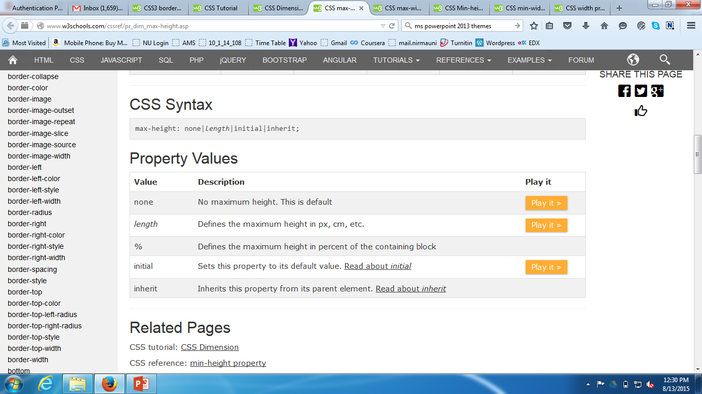
max-height property
The max-height property is used to set the maximum height of an element.
This prevents the value of the height property from becoming larger than max-height.
Note: The value of the max-height property overrides height.
Example

Slide 5
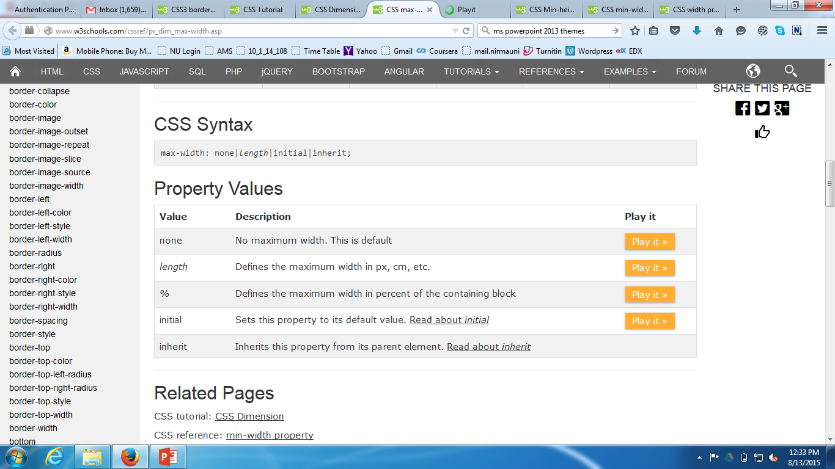
max-width property
The max-width property is used to set the maximum width of an element.
This prevents the value of the width property from becoming larger than max-width.
Note: The value of the max-width property overrides width.
Example

Slide 6
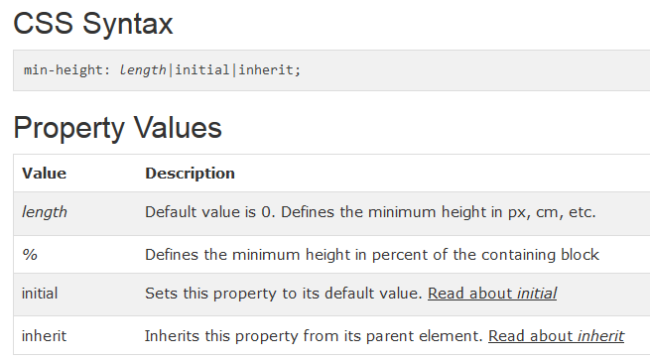
min-height property
The min-height property is used to set the minimum height of an element.
This prevents the value of the height property from becoming smaller than min-height.
Note: The value of the min-height property overrides both max-height and height.
Example

Slide 7
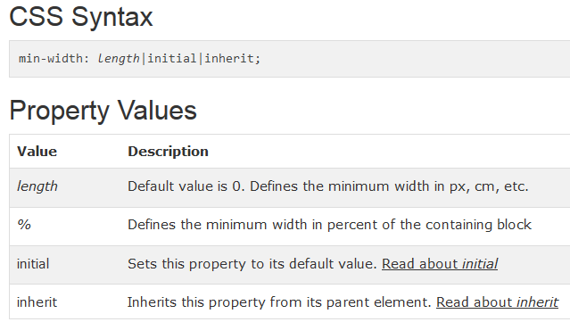
min-width property
The min-width property is used to set the minimum width of an element.
This prevents the value of the width property from becoming smaller than min-width.
Note: The value of the min-width property overrides both max-width and width.
Example

Slide 8
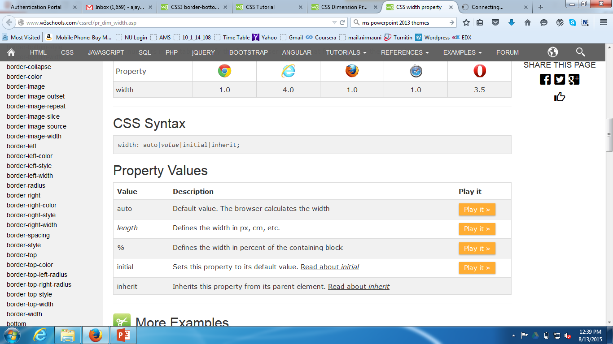
width property
The width property sets the width of an element.
Note: The width property does not include padding, borders, or margins; it sets the width of the area inside the padding, border, and margin of the element!
Note: The min-width and max-width properties override width.
Example

Slide 9
CSS: Box Model
All HTML elements can be considered as boxes. In CSS, the term "box model" is used when talking about design and layout.
The CSS box model is essentially a box that wraps around HTML elements, and it consists of: margins, borders, padding, and the actual content.
The box model allows us to add a border around elements, and to define space between elements.
The image In next slide illustrates the box model:

Slide 10
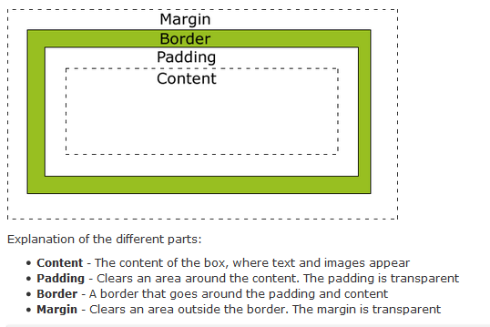
CSS: Box Model (contd…)

Slide 11
CSS: Box Model (contd…)
css_boxdemo.html
Width and Height of an Element
In order to set the width and height of an element correctly in all browsers, you need to know how the box model works.
Important: When you set the width and height properties of an element with CSS, you just set the width and height of the content area. To calculate the full size of an element, you must also add padding, borders and margins.

Slide 12
CSS: Box Model (contd…)
Let's style a <div> element to have a total width of 350px:
div
{ width: 320px; padding: 10px; border: 5px solid gray; margin: 0; }
box_w_h.html

Slide 13
CSS: Box Model (contd…)
Let's do the math: 320px (width) + 20px (left + right padding) + 10px (left + right border) + 0px (left + right margin) = 350px
The total width of an element should be calculated like this:
Total element width = width + left padding + right padding + left border + right border + left margin + right margin
The total height of an element should be calculated like this:
Total element height = height + top padding + bottom padding + top border + bottom border + top margin + bottom margin

Slide 14
Margins Properties
The margin clears an area around an element (outside the border). The margin does not have a background color, and is completely transparent.
List of dimension properties are as follows:
margin-bottom
margin-top
margin-left
margin-right
margin

Slide 15
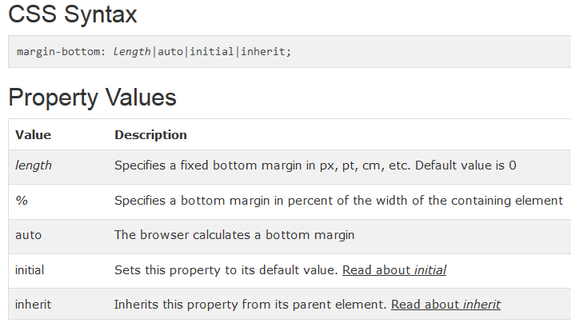
margin-bottom property
The margin-bottom property sets the bottom margin of an element.
Example

Slide 16
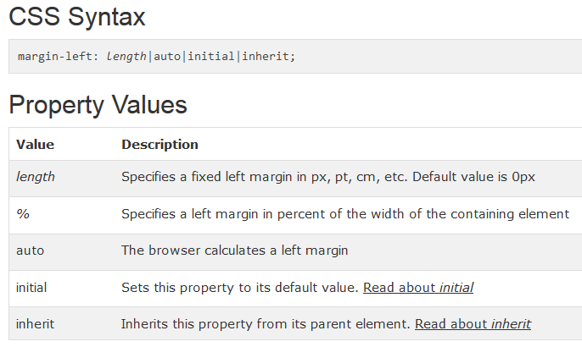
margin-left property
The margin-left property sets the left margin of an element.
Example

Slide 17
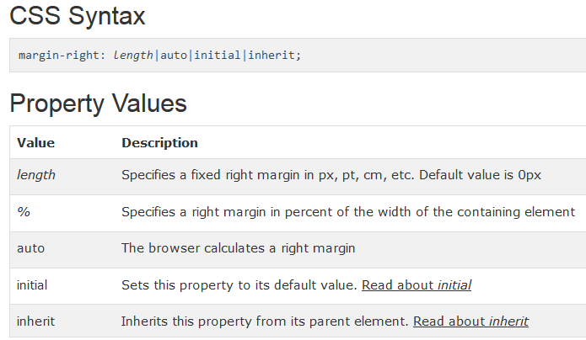
margin-right property
The margin-right property sets the right margin of an element.
Example

Slide 18
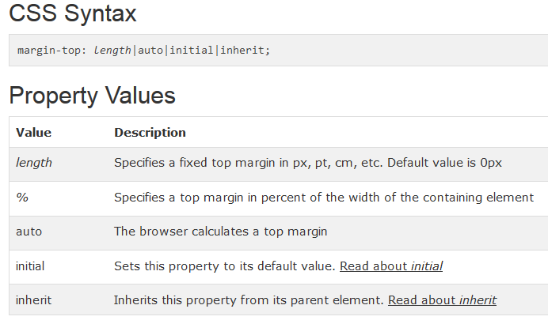
margin-top property
The margin-top property sets the top margin of an element.
Example

Slide 19
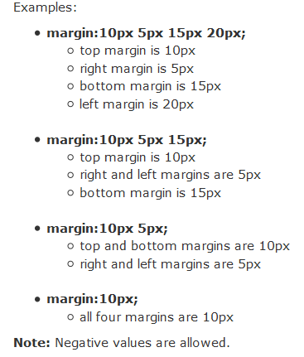
margin property
The margin shorthand property sets all the margin properties in one declaration. This property can have from one to four values.
Example

Slide 20
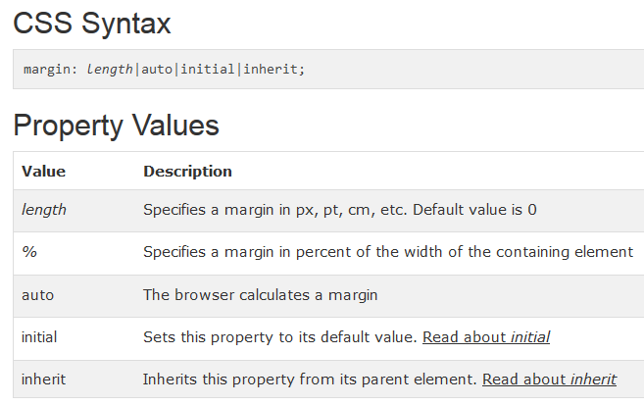
margin property

Slide 21
Padding Properties
The padding clears an area around the content (inside the border) of an element. The padding is affected by the background color of the element.
The top, right, bottom, and left padding can be changed independently using separate properties. A shorthand padding property can also be used, to change all paddings at once.
List of padding properties are as follows:
padding-bottom
padding-left
padding-right
padding-top
padding

Slide 22
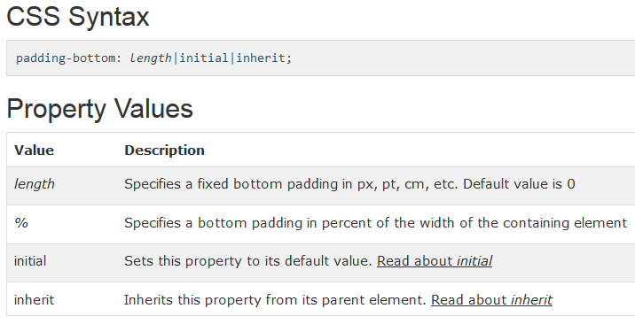
padding-bottom Property
The padding-bottom property sets the bottom padding (space) of an element.
Note: Negative values are not allowed.
Example

Slide 23
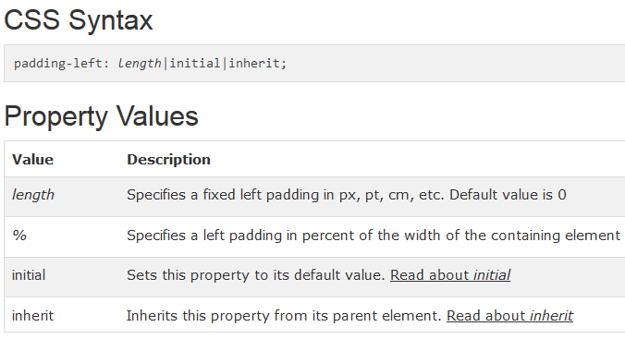
padding-left Property
The padding-left property sets the left padding (space) of an element.
Note: Negative values are not allowed.
Example

Slide 24
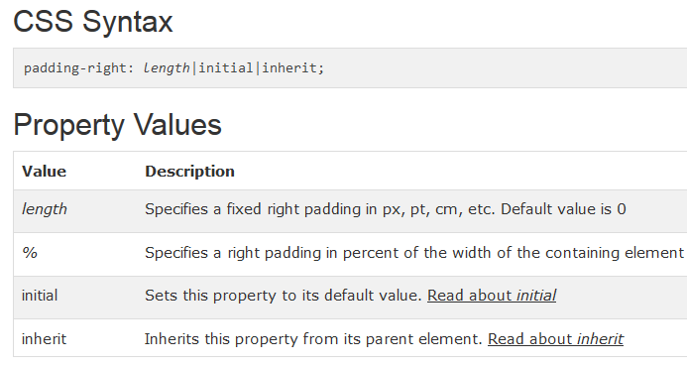
padding-right Property
The padding-right property sets the right padding (space) of an element.
Note: Negative values are not allowed.
Example

Slide 25
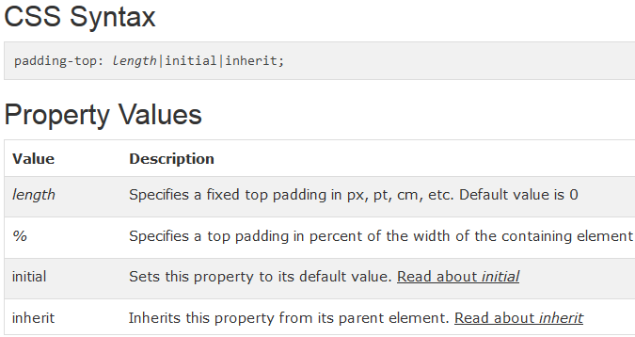
padding-top Property
The padding-top property sets the top padding (space) of an element.
Note: Negative values are not allowed.
Example

Slide 26
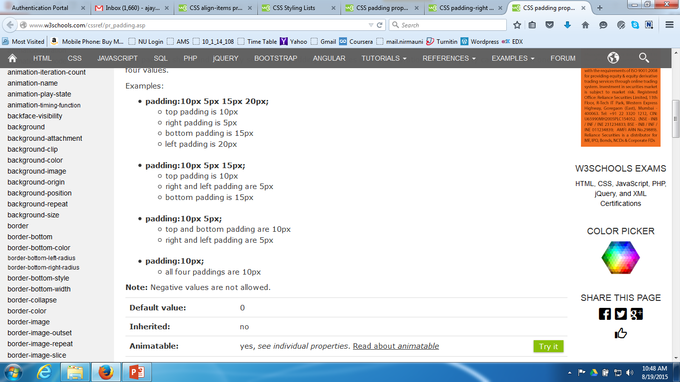
padding Property
The padding shorthand property sets all the padding properties in one declaration. This property can have from one to four values.
Example

Slide 27
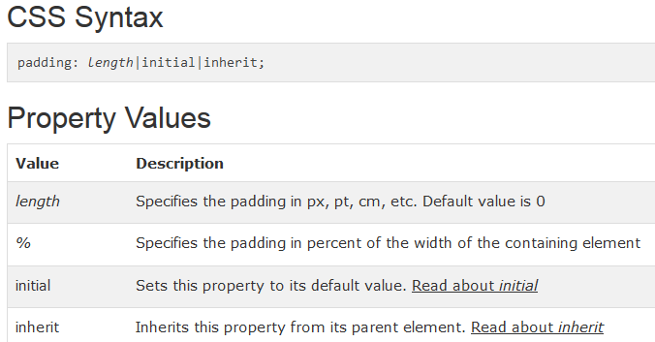
padding Property

Slide 28
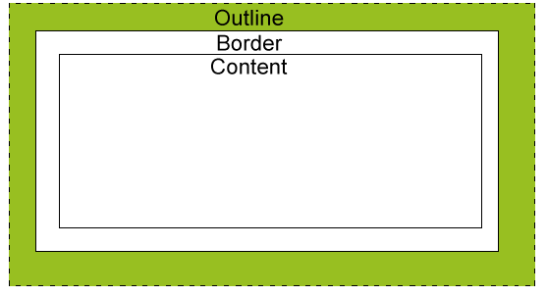
Outline Properties
An outline is a line that is drawn around elements (outside the borders) to make the element "stand out".
However, the outline property is different from the border property.
The outline is not a part of an element's dimensions; the element's total width and height is not affected by the width of the outline.

Slide 29
Outline Properties
List of Outline properties are as follows:
outline-color
outline-style
outline-width
outline-offset
outline

Slide 30
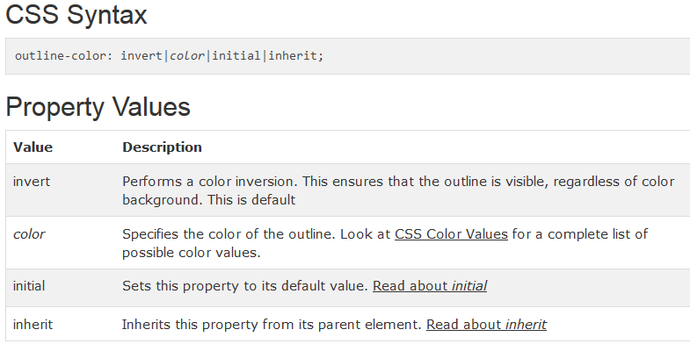
outline-color Property
An outline is a line that is drawn around elements (outside the borders) to make the element "stand out".
The outline-color property specifies the color of an outline.
Note: Always declare the outline-style property before the outline-color property. An element must have an outline before you change the color of it.
Example

Slide 31
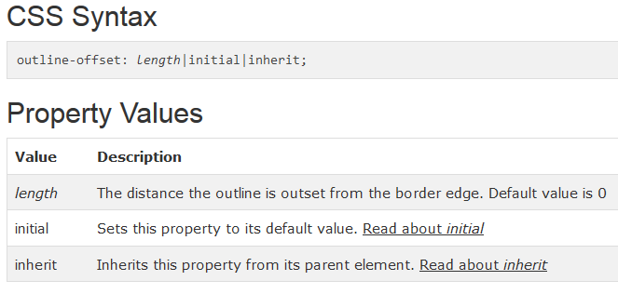
outline-offset Property
The outline-offset property adds space between an outline and the edge or border of an element.
Outlines differ from borders in two ways:
An outline is a line drawn around elements, outside the border edge
A outline do not take up space
An outline may be non-rectangular
Example

Slide 32
outline-style Property
An outline is a line that is drawn around elements (outside the borders) to make the element "stand out".
The outline-style property specifies the style of an outline.
Example

Slide 33
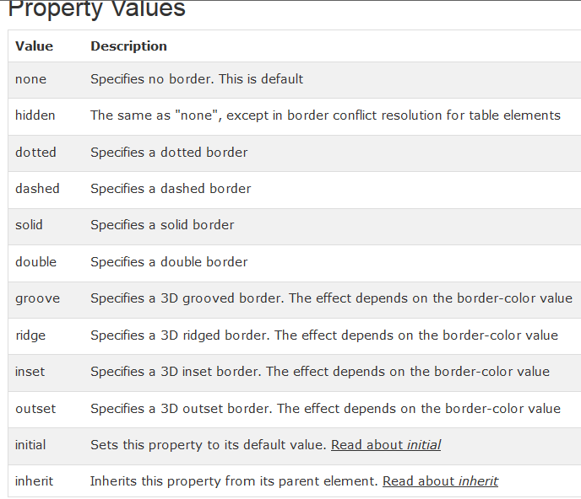
outline-style Property

Slide 34
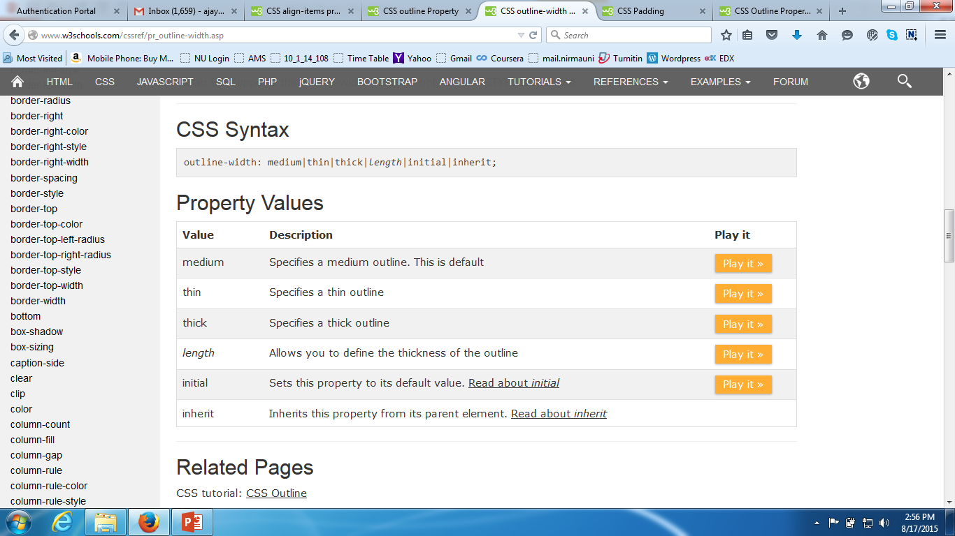
outline-width Property
An outline is a line that is drawn around elements (outside the borders) to make the element "stand out".
The outline-width specifies the width of an outline.
Note: Always declare the outline-style property before the outline-width property. An element must have an outline before you change the width of it.
Example

Slide 35
outline Property
An outline is a line that is drawn around elements (outside the borders) to make the element "stand out".
The outline shorthand property sets all the outline properties in one declaration.
The properties that can be set, are (in order): outline-color, outline-style, outline-width.
If one of the values above are missing, e.g. "outline:solid #ff0000;", the default value for the missing property will be inserted, if any.
Note: The outline is not a part of the element's dimensions, therefore the element's width and height properties do not contain the width of the outline.
Example

Slide 36
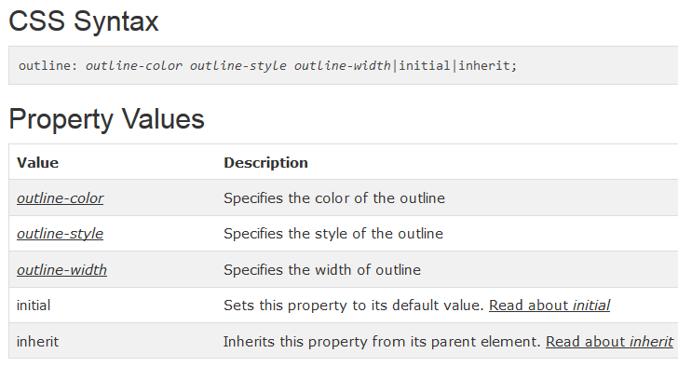
outline Property

Slide 37
List Properties
The CSS list properties allow you to:
Set different list item markers for ordered lists
Set different list item markers for unordered lists
Set an image as the list item marker
List of “List” properties are as follows:
list-style-image
list-style-type
list-style-position
list-style

Slide 38
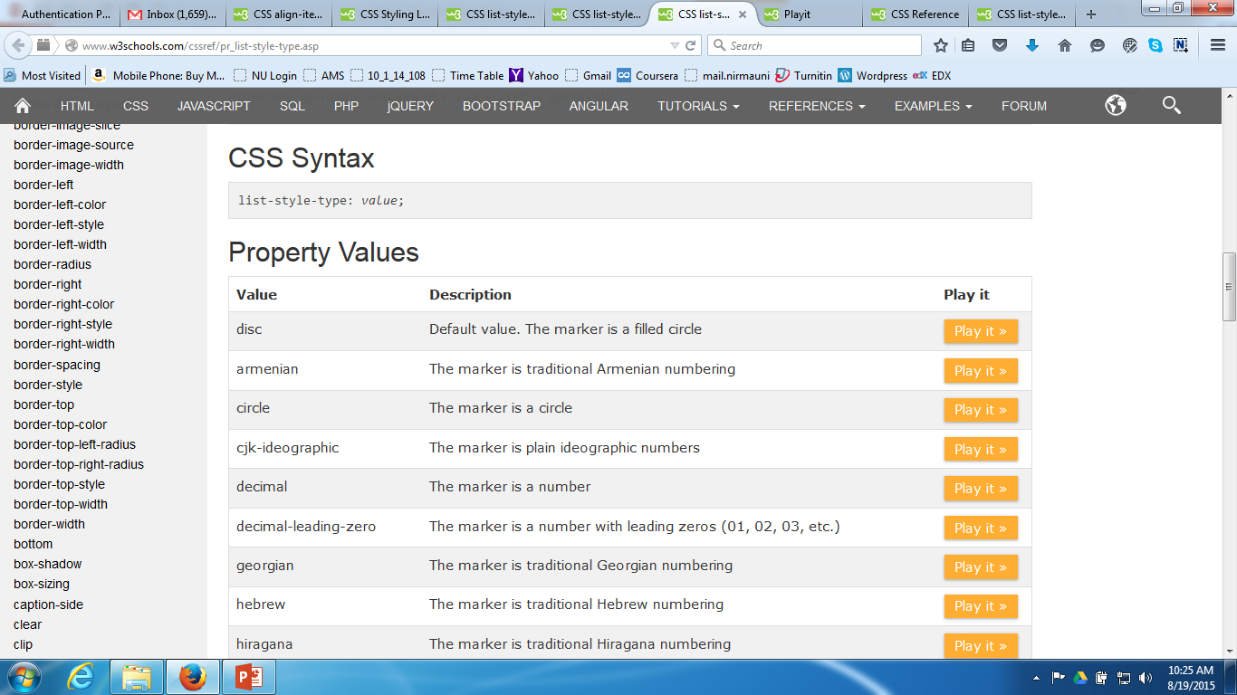
list-style-type Property
The list-style-type specifies the type of list-item marker in a list.
Example

Slide 39
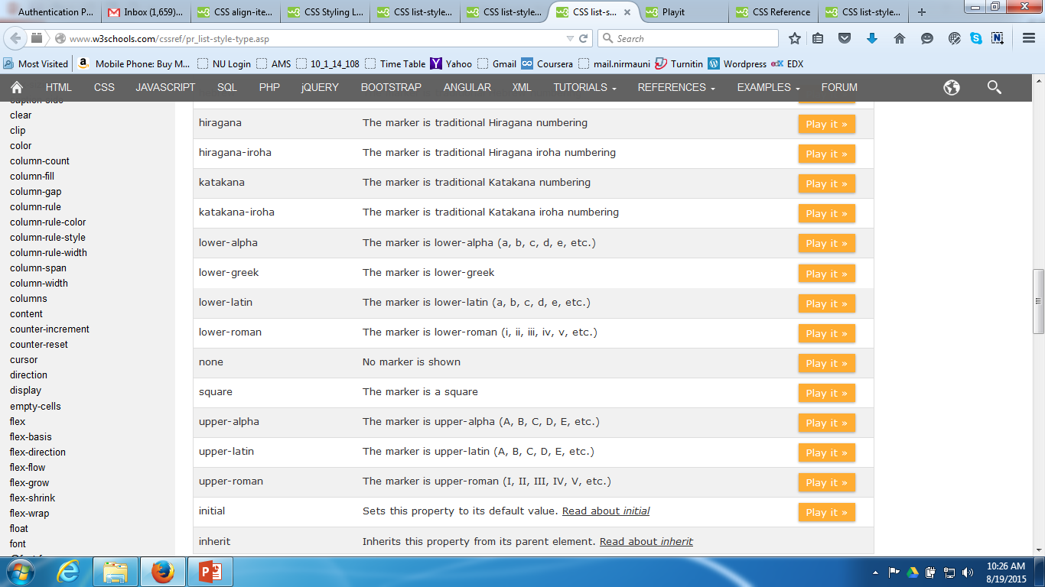
list-style-type Property

Slide 40
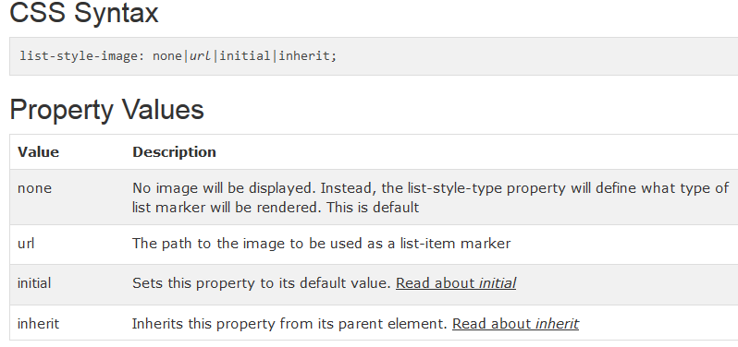
list-style-image Property
The list-style-image property replaces the list-item marker with an image.
Note: Always specify the list-style-type property in addition. This property is used if the image for some reason is unavailable.
Example

Slide 41
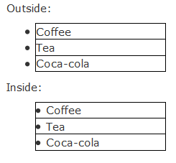
list-style-position Property
The list-style-position property specifies if the list-item markers should appear inside or outside the content flow.
Example

Slide 42
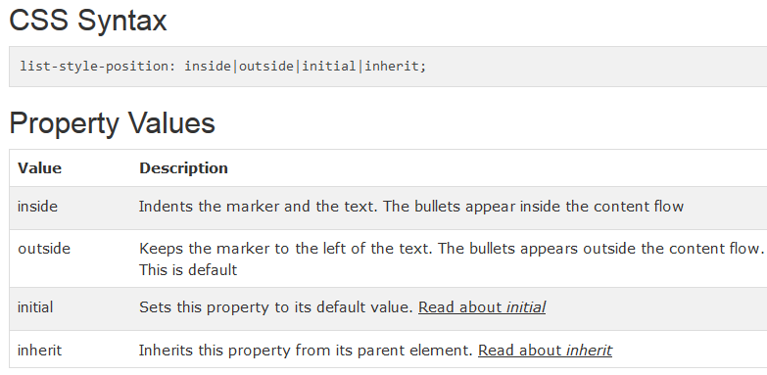
list-style-position Property

Slide 43
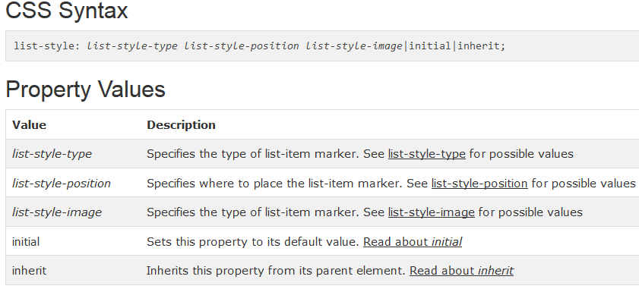
list-style Property
The list-style shorthand property sets all the list properties in one declaration.
The properties that can be set, are (in order): list-style-type, list-style-position, list-style-image.
If one of the values above are missing, e.g. "list-style:circle inside;", the default value for the missing property will be inserted, if any.
Example

Slide 44
Layout → Display Properties
The display property is the most important CSS property for controlling layout.
The display property specifies if/how an element is displayed.
Every HTML element has a default display value depending on what type of element it is. The default display value for most elements is block or inline.

Slide 45
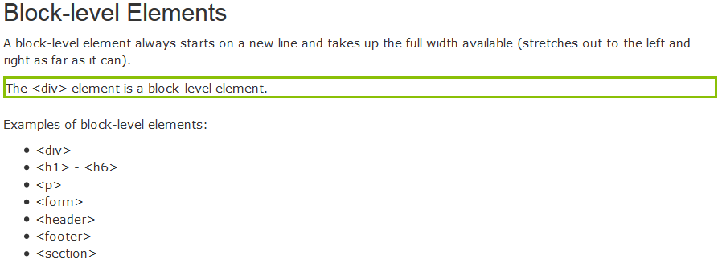
Layout → Display Properties

Slide 46
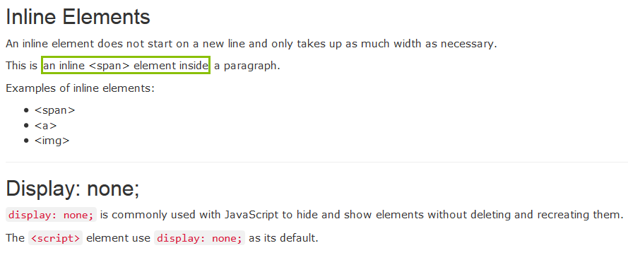
Layout → Display Properties

Slide 47
Layout → Display Properties
Example,
li {
display: inline;
}
Hide an Element - display:none or visibility:hidden?
Example
h1.hidden {
visibility: hidden;
}

Slide 48
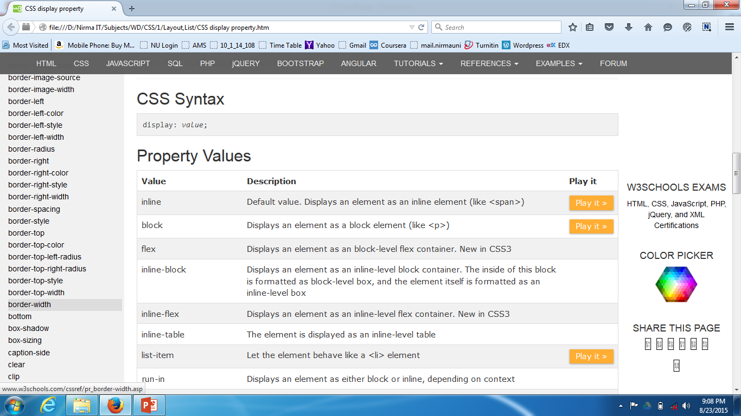
Layout → Display Properties

Slide 49
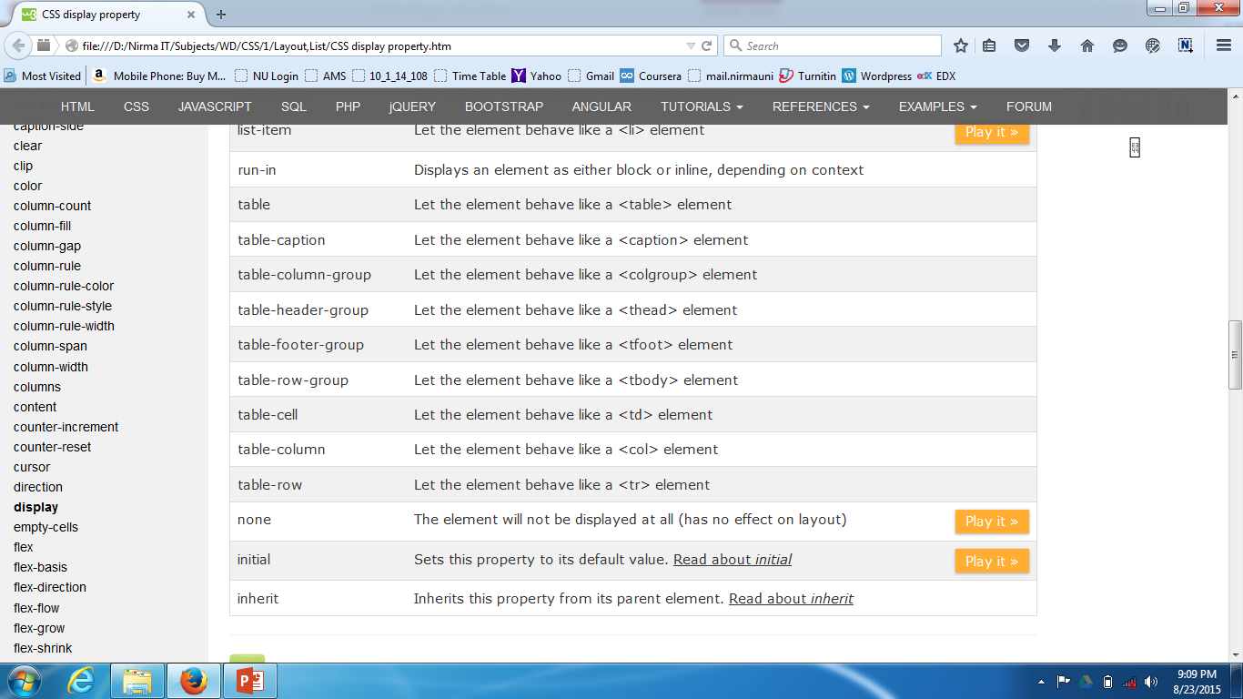
Layout → Display Properties

Slide 50
Table Properties
Example

Slide 51
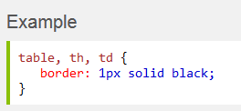
Table Borders
To specify table borders in CSS, use the border property.
The example below specifies a black border for <table>, <th>, and <td> elements:
Example

Slide 52
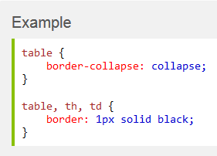
Collapse Borders
The border-collapse property sets whether the table borders are collapsed into a single border or separated:
Example

Slide 53
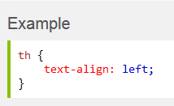
Horizontal Text Alignment
The text-align property sets the horizontal alignment, like left, right, or center.
By default, the text in <th> elements are center-aligned and the text in <td> elements are left-aligned.
The following example left-aligns the text in <th> elements:
Example

Slide 54
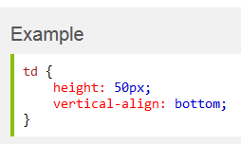
Vertical Text Alignment
The vertical-align property sets the vertical alignment, like top, bottom, or middle.
By default, the vertical alignment of text in a table is middle (for both <th> and <td> elements).
The following example sets the vertical text alignment to bottom for <td> elements:
Example

Slide 55
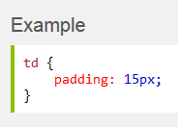
Table Padding
To control the space between the border and content in a table, use the padding property on <td> and <th> elements:
Example

Slide 56
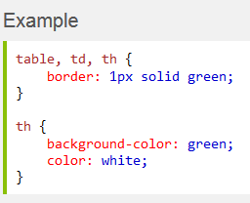
Table Color
The example below specifies the color of the borders, and the text and background color of <th> elements:
Example

Slide 57
Column related properties

Slide 58
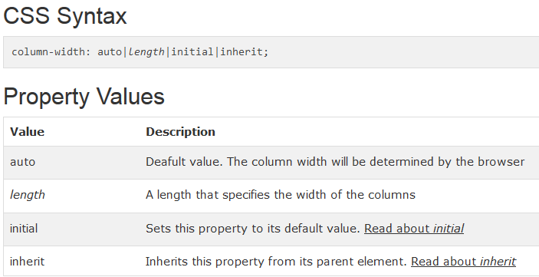
column-width Property
The column-width property specifies a suggested, optimal width for the columns.
Example

Slide 59
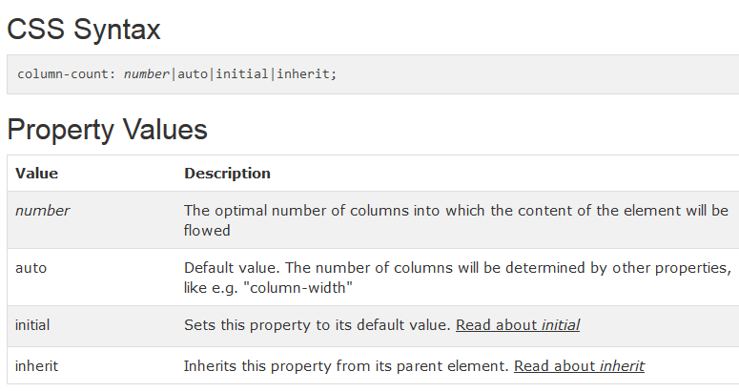
column-count Property
The column-count property specifies the number of columns an element should be divided into.
Example

Slide 60
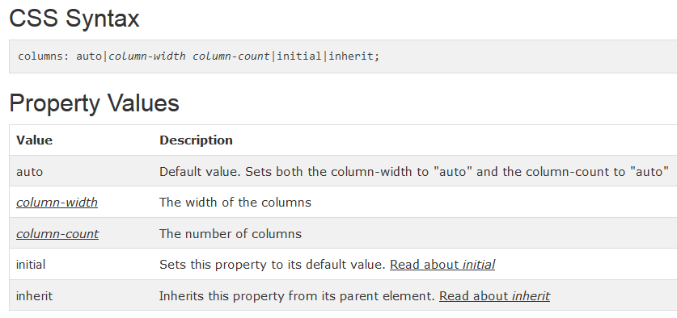
columns Property
The columns property is a shorthand property for setting column-width and column-count.
Example

Slide 61
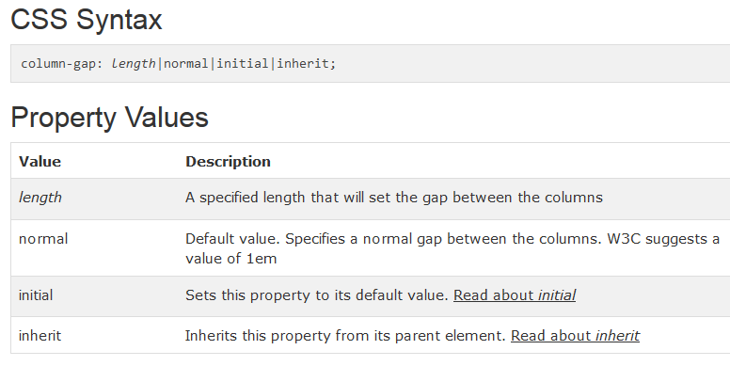
column-gap Property
The column-gap property specifies the gap between the columns.
Note: If there is a column-rule between columns, it will appear in the middle of the gap.
Example

Slide 62
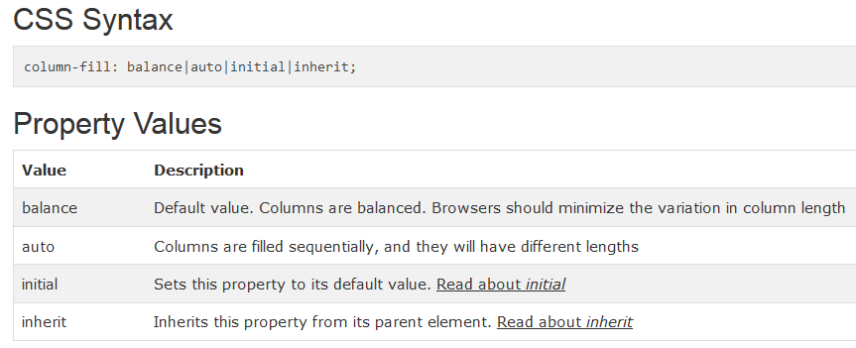
column-fill Property
The column-fill property specifies how to fill columns, balanced or not.
Example

Slide 63
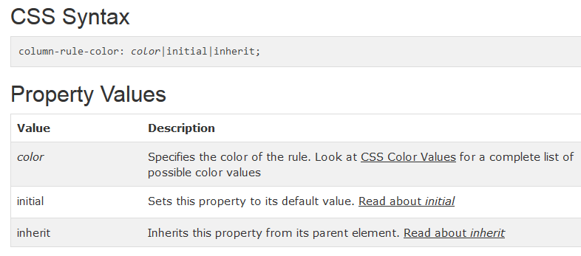
column-rule-color Property
The column-rule-color property specifies the color of the rule between columns.
Example

Slide 64
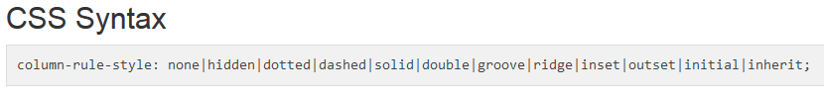
column-rule-style Property
The column-rule-style property specifies the style of the rule between columns.
Example

Slide 65
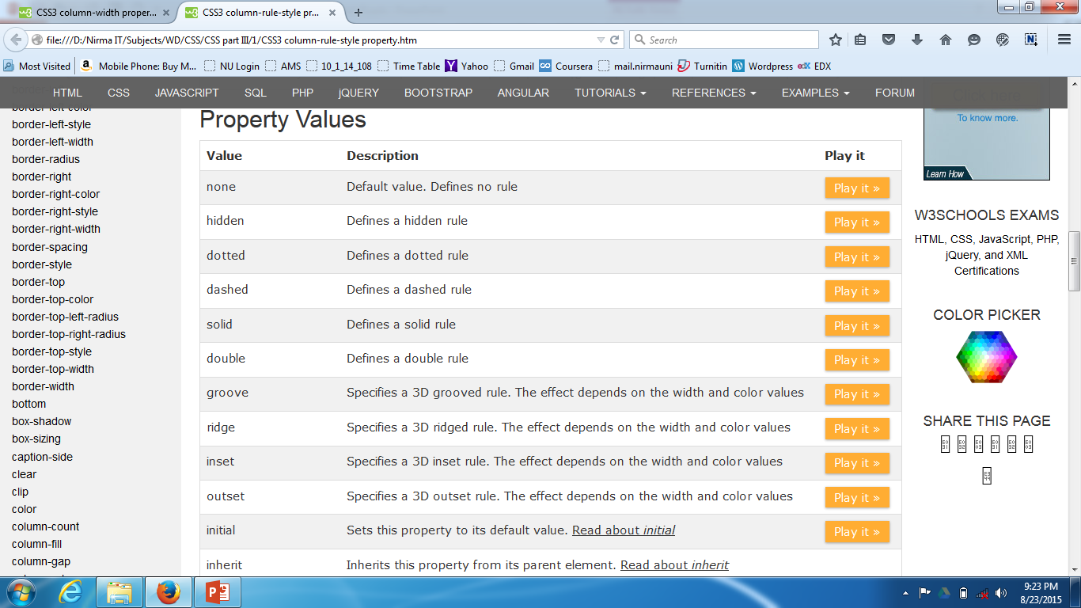
column-rule-style Property

Slide 66
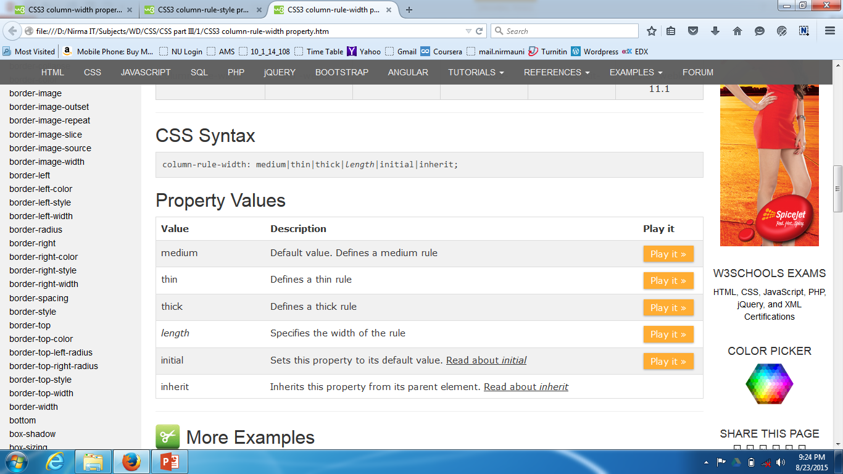
column-rule-width Property
The column-rule-width property specifies the width of the rule between columns.
Example

Slide 67

column-rule Property
The column-rule property is a shorthand property for setting all the column-rule-* properties.
The column-rule property sets the width, style, and color of the rule between columns
Example

Slide 68
References
http://www.w3schools.com/cssref/

Slide 69
Thank You…

